Slide 1

Tips for Job Searching

Slide 2
Life of a Junior Software Developer

Slide 3
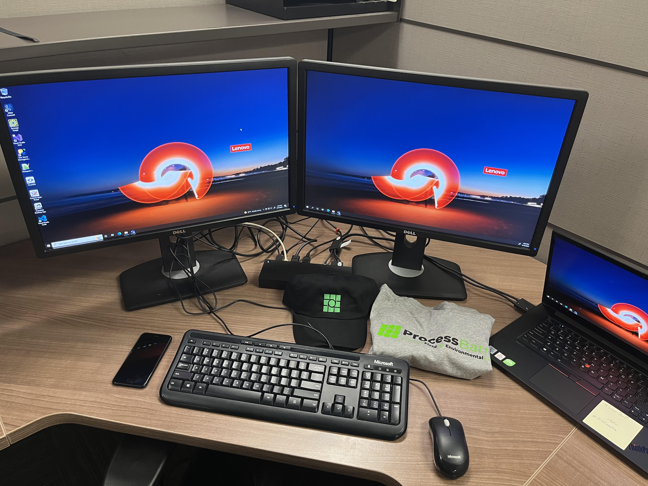

Slide 4

Where do I work?
Services that are offered include fan repair and rebuild, fuel and ash handling systems, air system auxiliary equipment, and field installation
Started as Process Equipment, Inc. in 1981
Licensing agreement with Raumaster Oy, a leading European materials handling company
Purchased Weigel Engineering—an engineering firm dedicated to repairing accessory parts for boilers and air heaters
Purchased Barron Industries in 2002—Process Equipment, Inc. officially becomes ProcessBarron
Purchased PE Flo-Tech—specialized in dampers, expansion joints, and air handling accessory parts
Recently purchased Southern Field Maintenance & Fabrication—still in the process of merging

Slide 5

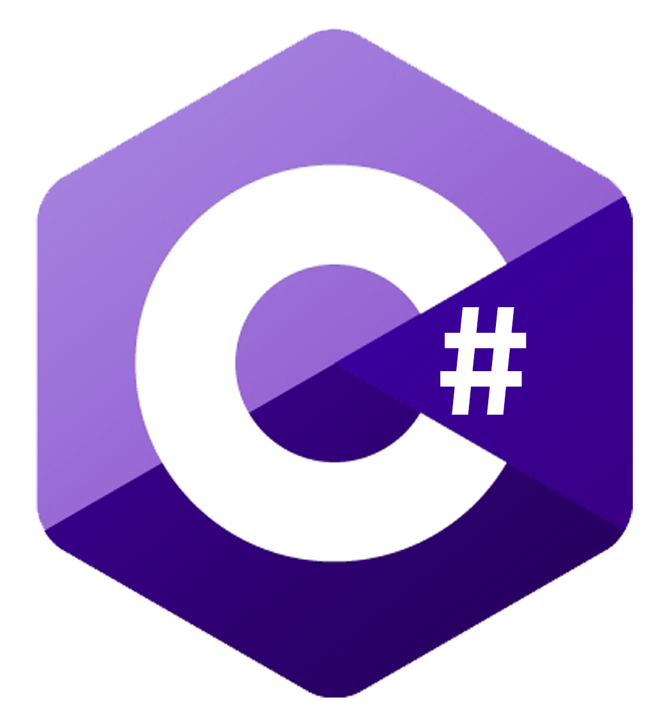
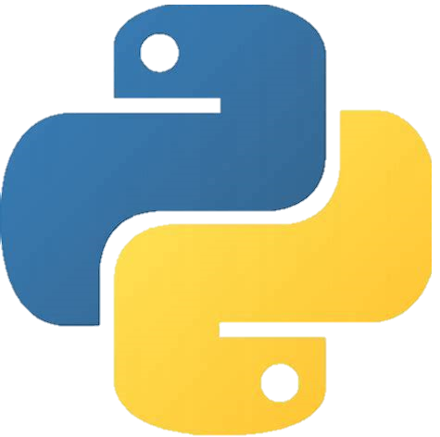


Languages that I use

Slide 6
Most recent projects

Slide 7
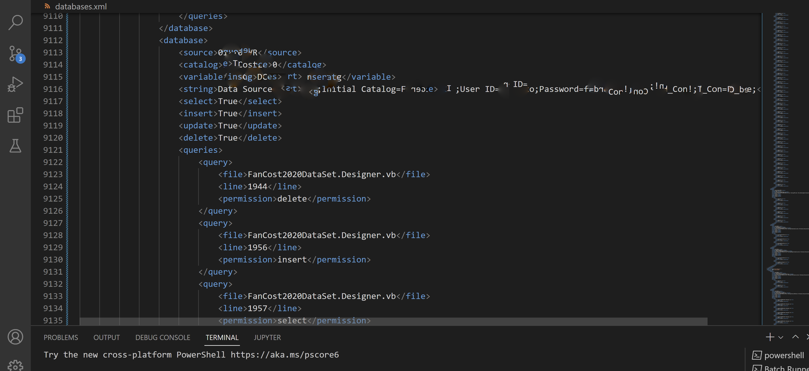

Slide 8
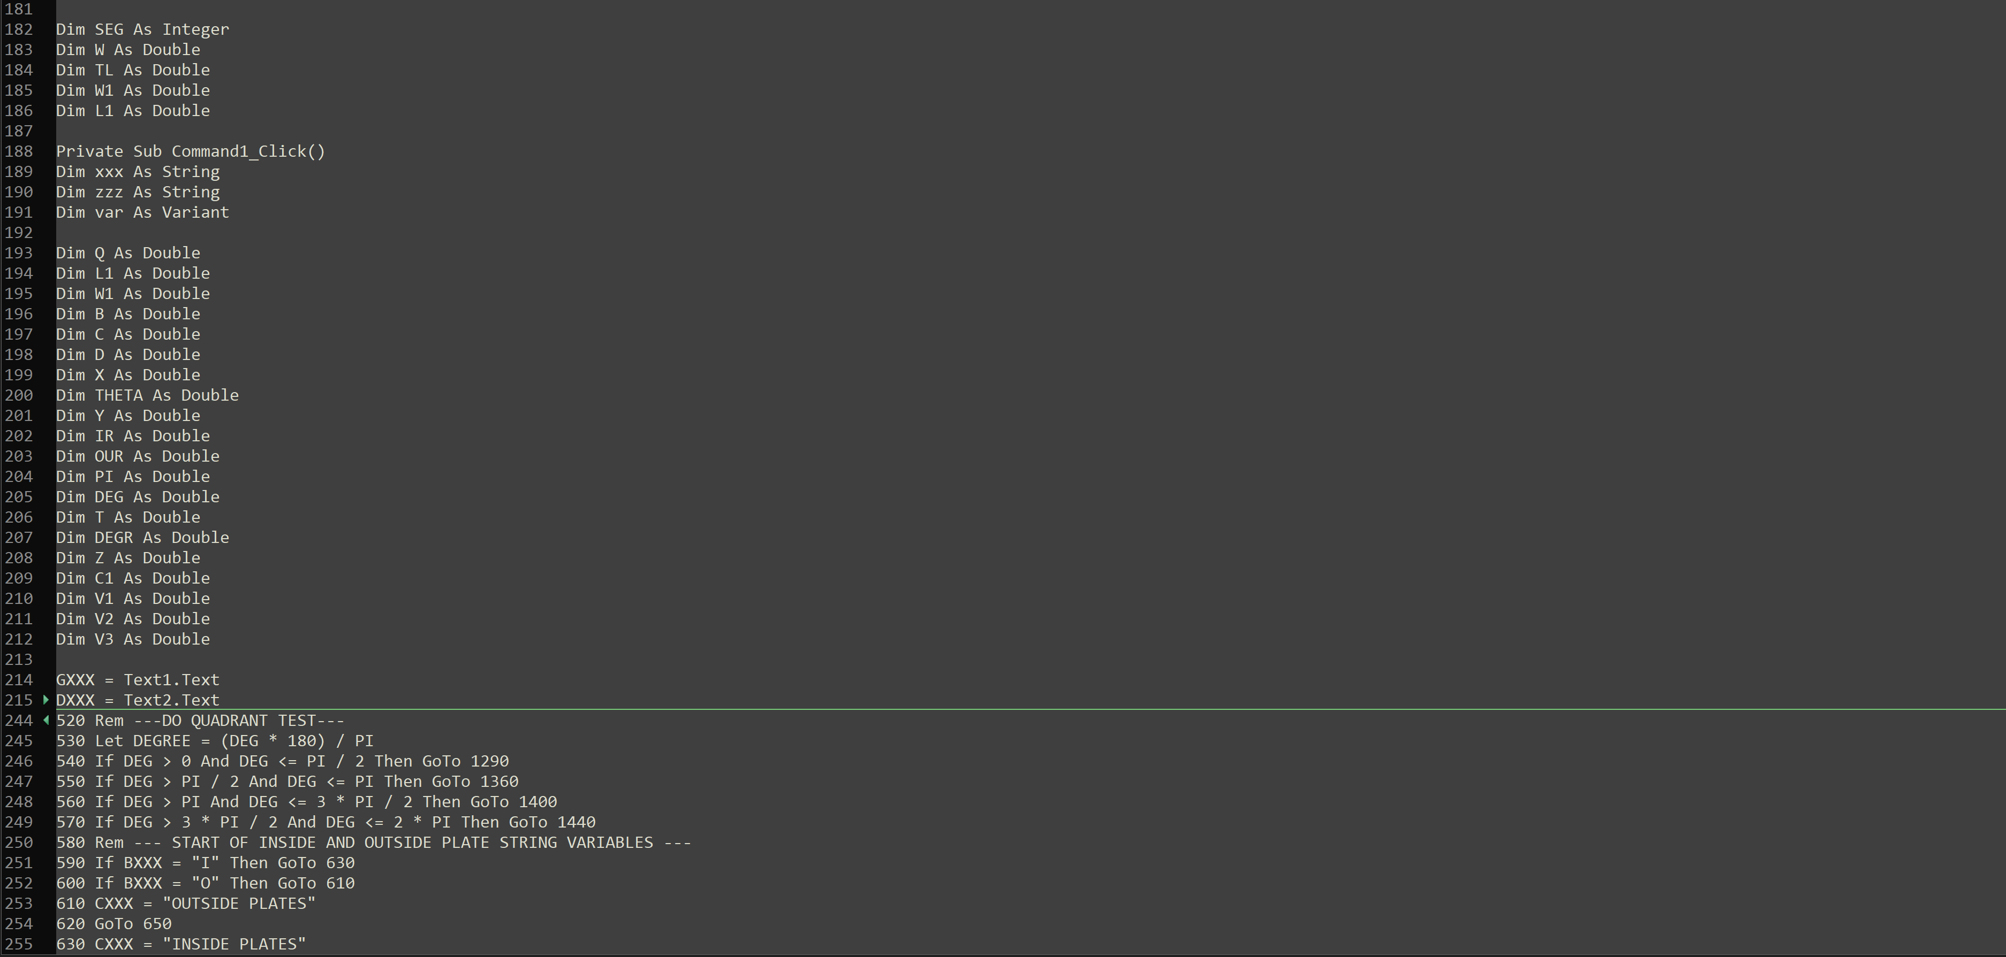

Slide 9
Finding a job/internship
Key Ingredients

Slide 10

You can find jobs!
Jobs can find you!
Not the only option out there, but it is a highly, highly, highly recommended option

Slide 11

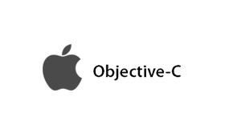








Common Job Requirements
Web Development
Frontend
Backend
Full stack (frontend + backend)
Mobile App Development
AI/ML Engineering
Software Development (depends)

Slide 12
Resume
Summary
Education
Courses
Skills
Projects
Experience
Unofficial Certifications

Slide 13
Resume (continued)
ATS
HR
Employer

Slide 14
Interviews
1 on 1
Coding Interview
Panel discussion
Research the company
Have answers ready for common questions
Show interest by asking questions
Practice LeetCode problems
Cracking the Coding Interview
Read the problem carefully
Do exactly as they ask
Most likely will ask questions about your coding interview
Be ready to explain why you did things one way and not another way

Slide 15
How to gain experience?
Projects (upload to GitHub)
Internships/jobs
Hackathons
Volunteer work (i.e., Computer Science Club)
Unofficial certifications (Coursera, Udemy, HackerRank, etc.)

Slide 16
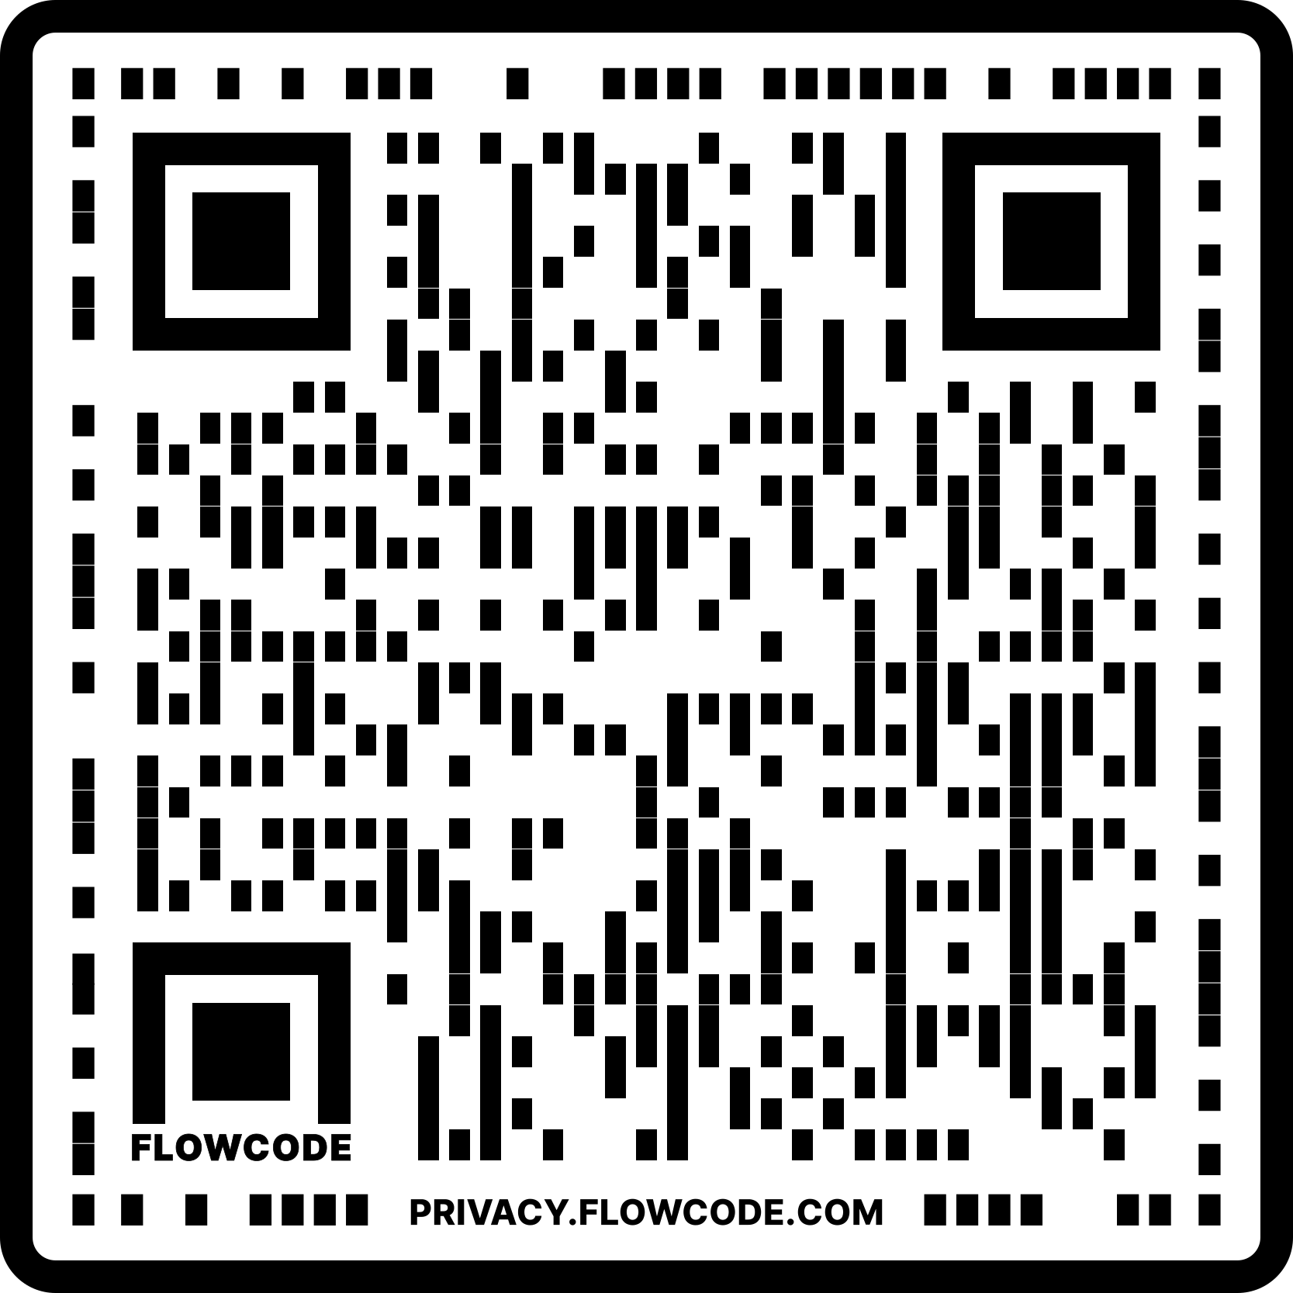
Any questions?
github.com/Jtmonument/job-searching-troy

